Slide 1
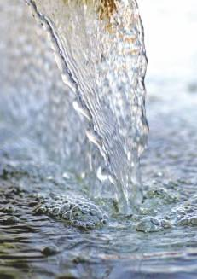
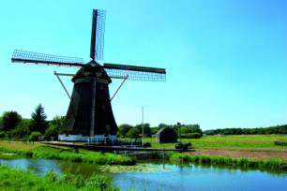
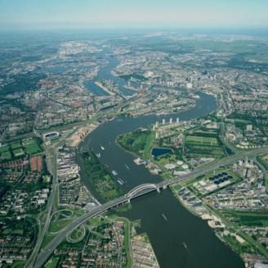
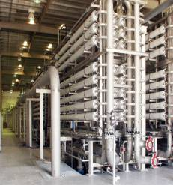
Netherlands Water Partnership
Jeroen van der Sommen
14 oktober 2008
February 2007
1 / <##>
Notes:
February 2007
NGWP
1

Slide 2

Contents
Introduction to Netherlands Water Partnership
Reference to NWP activities (see additional documentation)
Akvo.org

Slide 3
Dutch Watersector
NGO’s
Government
Knowledge institute
Private sector

Slide 4
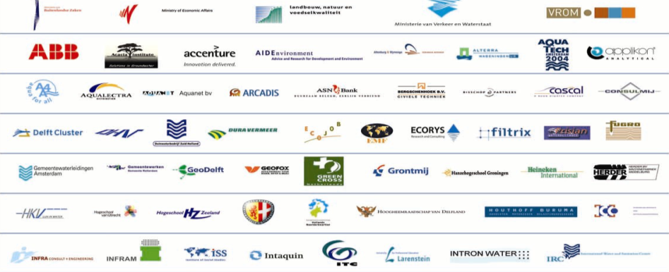
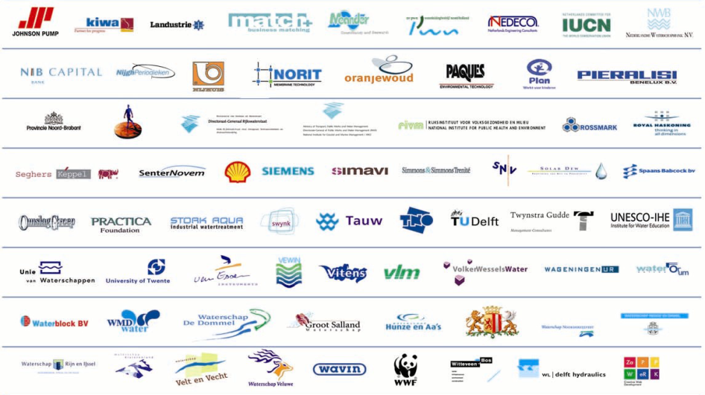
Netherlands Water Partnership

Slide 5



Events
Information
Business
Toekomstvisie
EWP
Innovatie Programs
Rapid Response Team/Risk Reduction Water Partnership
Millennium Development Goals
Human Capital Roadmap Water
CPWC
Delta
Technology
Water
Technology

Slide 6

Events
Exhibition
  Aquaterra
  Environment, VAE
  WETEX Dubai, VAE
  IndoWater 2007, Jakarta
  H20, Vietnam
  Saudi Water and Power Forum, Jeddah
  South-east Asia Water forum, Maleisie
  World Water Week 2007, Stockholm
  Yellow River Forum, China
  Int. Year of Sanitation
  Water export dagen EVD
  Dutch-Japanese Design Workshop
Events
Missions
  Matchmaking missie Zuid-Afrika
  Missie Asian Development Bank
  Factfinding Missie Florida Everglades
  Missie New Orleans & California
  Staatsbezoek India
  Levee conference California
  Factfinding Missie Brazilie
  Missie Maleisie
  Missie Singapore
  Missie Polen
  Missie Watertechnologie Israel
Doorkijk 2008
Events
Informatie
Business
Toekomstvisie
EWP
Innovatie Programma’s
Rapid Response Team/Risk Reduction Water Partnership
Millennium Development Goals
Human Capital Roadmap Water
CPWC
Delta
Technologie
Water
Technologie

Slide 7
Information
Website Waterland
Made in Holland (4x)
  BM (samen met EVD)
Communication
    Portfolio Delta Tech
    Portfolio Water Tech
    Water Tech Israel
    Microfinance & water
    Events booklets
    Indonesie special
    Singapore booklets
    Netherlands-Gulf Region Water Platform
    AT@WORK brochure
    Dutch Groundwater
Doorkijk 2008
Events
Informatie
Business
Toekomstvisie
EWP
Innovatie Programma’s
Rapid Response Team/Risk Reduction Water Partnership
Millennium Development Goals
Human Capital Roadmap Water
CPWC
Delta
Technologie
Water
Technologie

Slide 8
Business
Country Platforms
  VS
  VAE
  Turkije
  Vietnam
  India
  Indonesie
  Roemenie
  China
2g@there --> Golf regio en VS
IBM, Philips, GE
Projects
    USA
    VAE
    Indonesie
Doorkijk 2008
Events
Informatie
Business
Toekomstvisie
EWP
Innovatie Programma’s
Rapid Response Team/Risk Reduction Water Partnership
Millennium Development Goals
Human Capital Roadmap Water
CPWC
Delta
Technologie
Water
Technologie

Slide 9
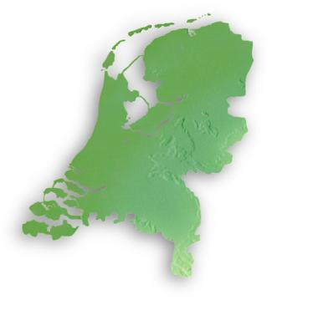
Doorkijk 2008
B KI
O N
Water sector
Deltatechnologie
MDG
Watertechnologie
Nederland
Notes:
9

Slide 10

Thematic en Regional Clusters
Watertechnologie
Water technology
Amsterdam Initiatives
Membrane Valley
Water and climate/green
Water and health
Salt/sweet/silt
Aqua dock Rotterdam
Delta technology
Int. Publiek/Private Sam.
Vitaal Water
Sensor and Remote Sensing
Twente Water Centre
EWP
Waterhuis Kiwa
Watertechnologie
Watertechnologie
Notes:
10

Slide 11
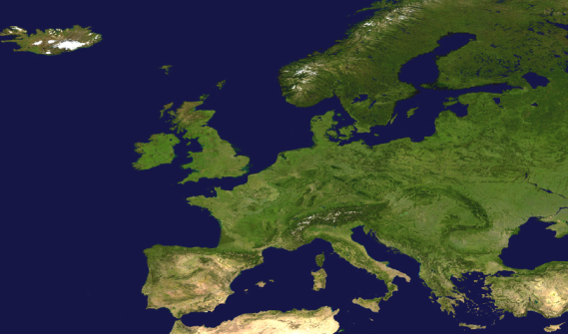
Doorkijk 2008
B KI
O N
Water sector
Deltatechnologie
MDG
Watertechnologie
Nederland
Europa
Notes:
11

Slide 12
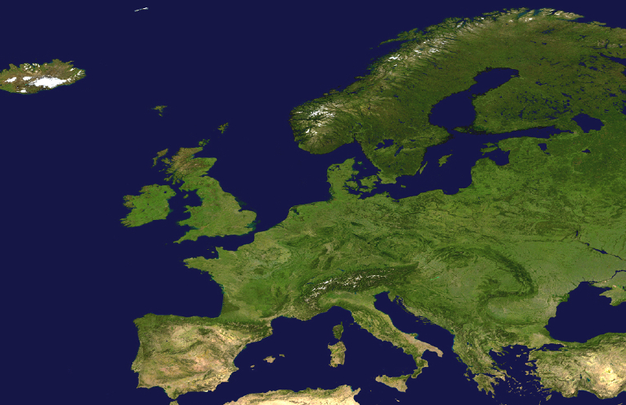
European Water Partnership
Water Stewardship
- Instrument for sustainable water man.
- Water integral part of policy/agendas
- Water footprint
Aquawareness
Creating mindset: a water saving culture
Create awareness
Support the change of behaviour
Preparation WWF 5
Aquawarenss
Project development
Kaderrichtlijn Water (water quality program)
Climate adaptation
EWP development
Upscaling Dutch sustainability agenda to European level
Notes:
February 2007
NGWP
12

Slide 13
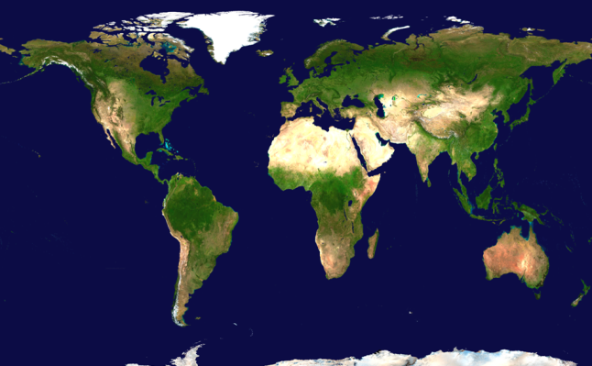
Doorkijk 2008
B KI
O N
Water sector
Deltatechnologie
MDG
Watertechnologie
Nederland
Europa
Wereld
Notes:
13

Slide 14
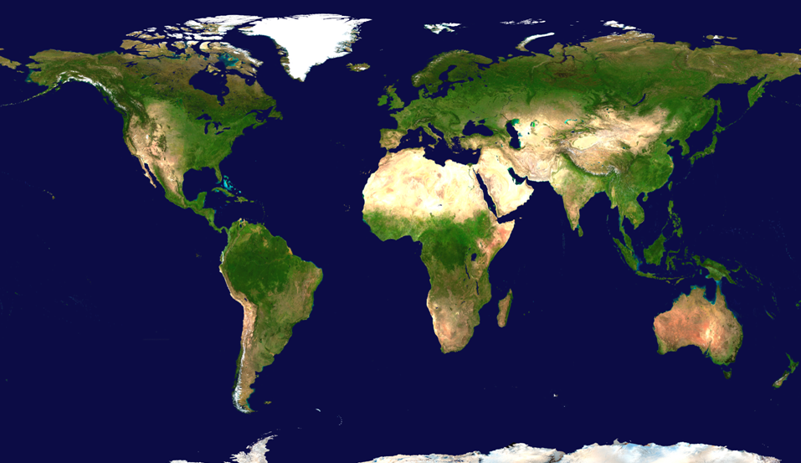
Focuslanden sector / overheid
Rusland
Roemenië
China
USA
Turkije
VAE
India
Vietnam
Indonesië
Brazilië
Mozambique
Zuid-Afrika
Notes:
14

Slide 15




Deltafocus
Egypte [Nijl]
Vietnam [Mekong]
India [Ganges]
Indonesie [Kust]
Notes:
15

Slide 16
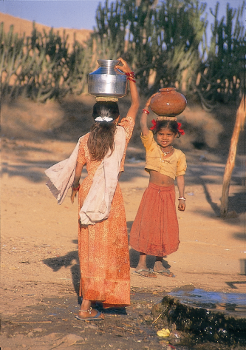
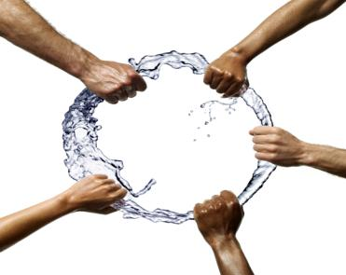
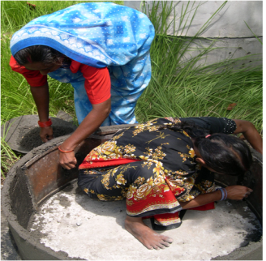
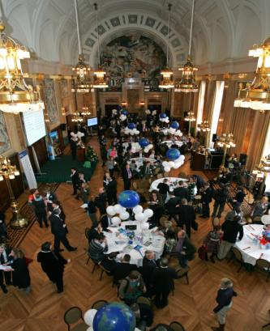
Water sector and sanitation

Slide 17
Trends International Water sector
1980s
1990s
2000-2007
Population growth and urbanization
PHYSICAL
Growing competition for natural resources
Scarcity Worsening water quality Groundwater depletion Climate stress
Hierarchical
Top-down state interventions
Market-led
Enter the private sector
Distributed
Enter civil society
Watertechnology
Emergence of developing countries in global debate
Decentralization
Globalization
Hydraulic engineering
Integrated approaches
Living with water/Building with nature
Deltatechnology
Emergence of developing countries in global debate
Decentralization
Globalization
Source: Worldbank
Notes:
17

Slide 18
Water sector developments
Water sector developments are a slow track
What happens outside the water sector, is going on at tremendous speed!
Big companies approach the water problems from different perspectives
Water problems are big, so deliver big!

Slide 19
BIG problems; deliver BIG!
Akvo

Slide 20
Cost of communication goes towards zero

Slide 21
“Bicycle for sale”
(note at the local store)

Slide 22
eBay:
87 million users
US$ 60 billion

Slide 23
Inspiration from different sources

Slide 24
Wikipedia
Blogger
Scale
YouTube
eBay

Slide 25
Match projects and funds Akvo Direct
Akvo helps you scale
Share knowledge Akvopedia
Simplify reporting Akvo RSR

Slide 26
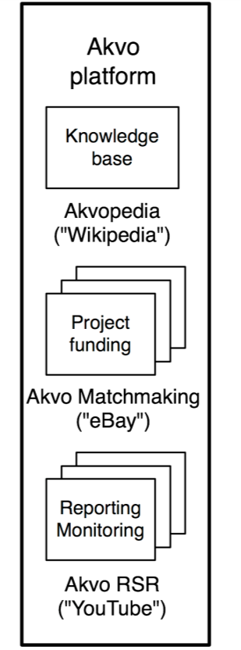
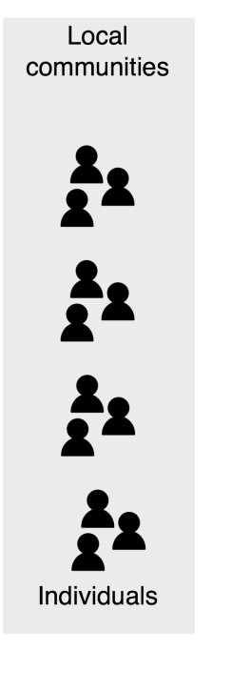
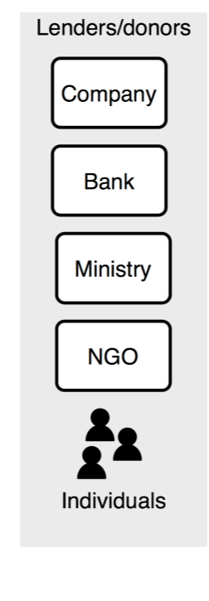
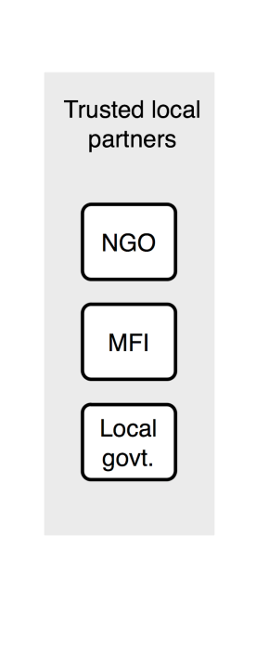
Notes:
Goede opening sheet

Slide 27
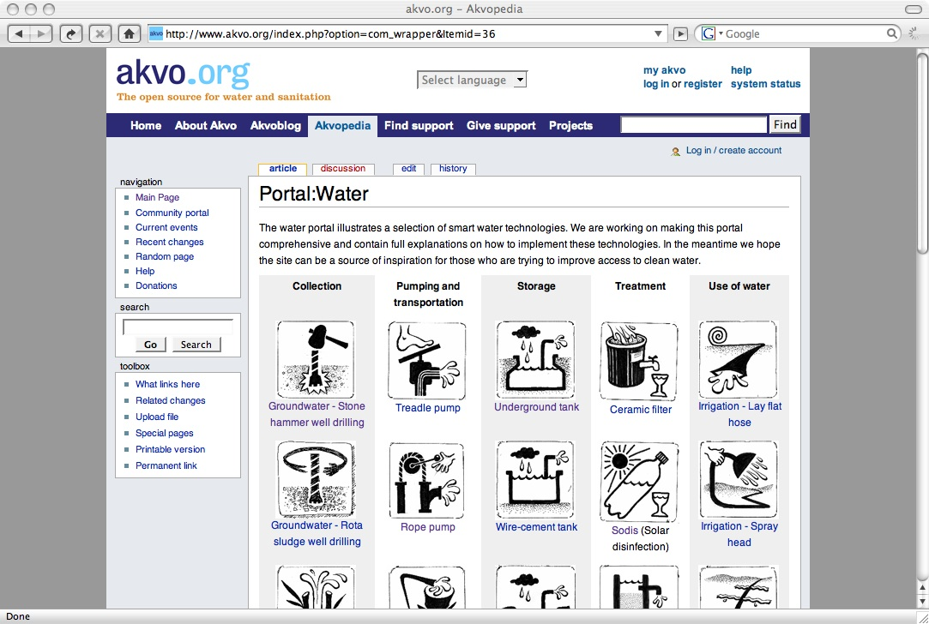

Knowledge

Slide 28
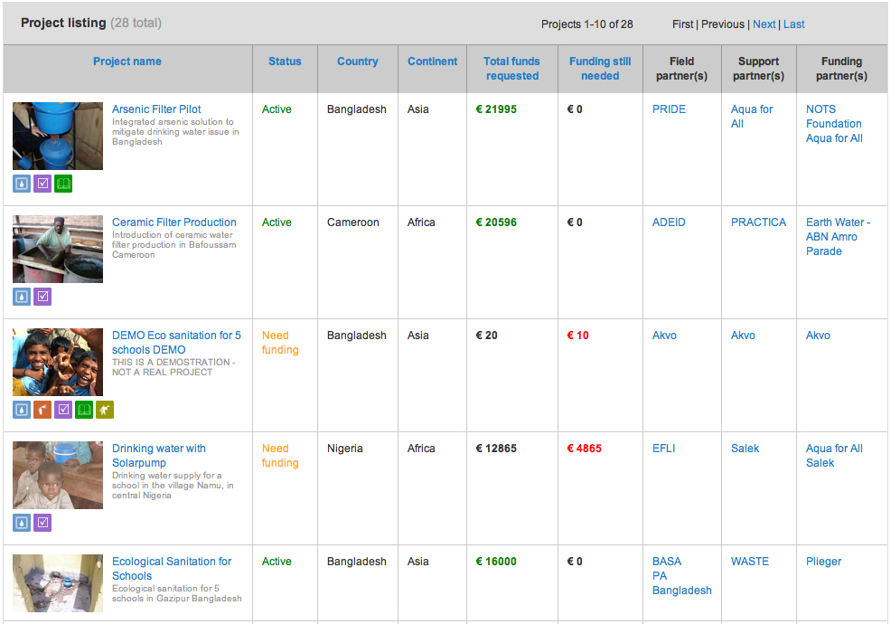
Funding

Slide 29
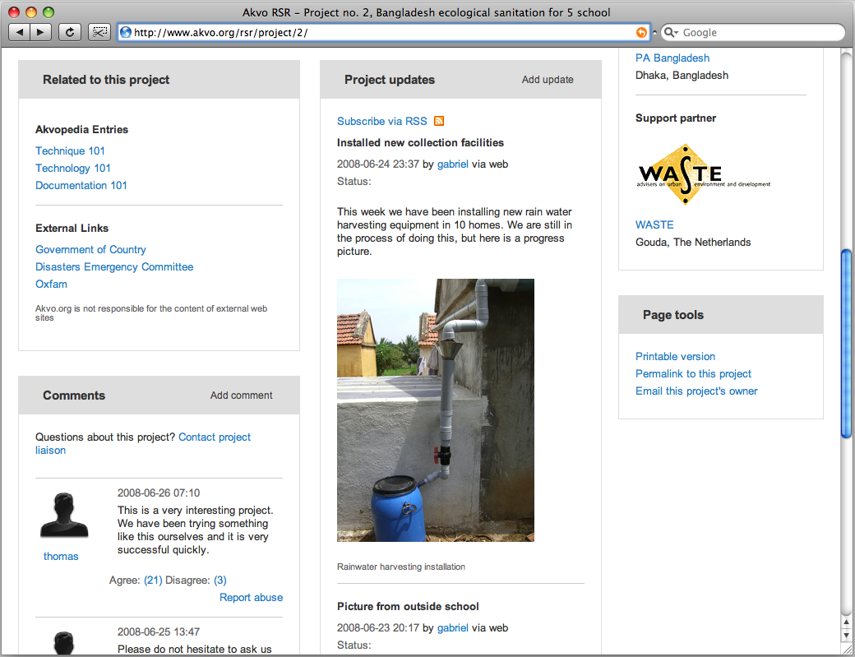
Reporting

Slide 30
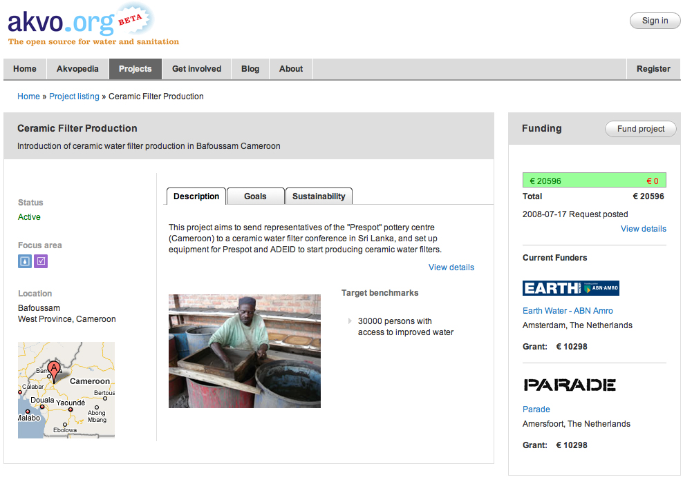
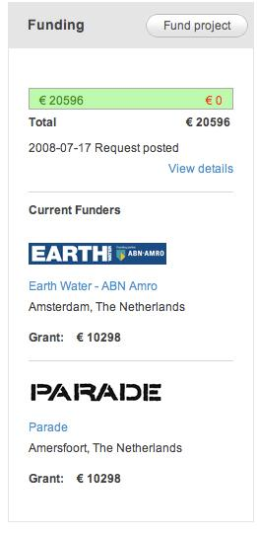
Project example

Slide 31
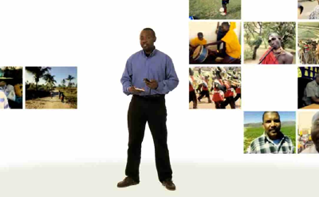
African Reporters

Slide 32
